Slide 1


Array Methods in Javascript.

Slide 2


1. toString
When called on an array, it converts each element to a string and joins them with commas.

Slide 3


2. Join
Merges elements of an array using the specified combinator.

Slide 4
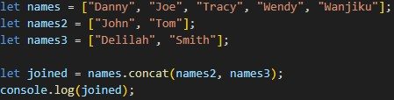

3. Concat
Used to combine different arrays together

Slide 5
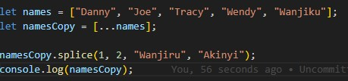

4. Splice
Removing some elements from the array, while also adding new elements.

Slide 6
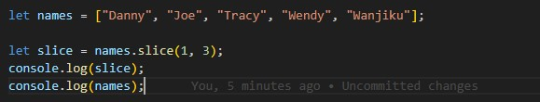
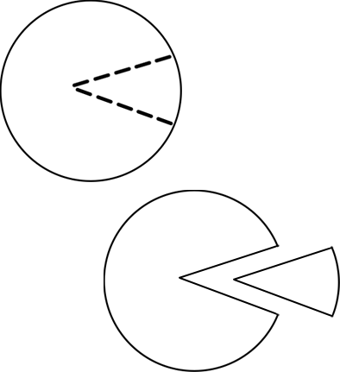
5.Slice
To slice out elements of an array

Slide 7

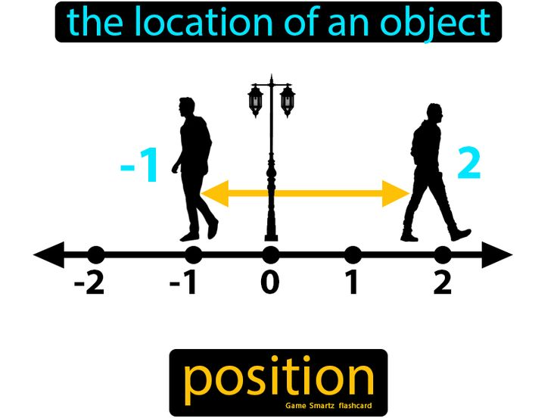
6. Index of
Finds the position of an individual element in the array.

Slide 8

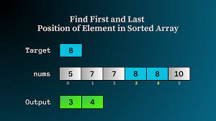
7.Lastindexof
Search for the last occurrence of a specified value in an array and returns the index of the last occurrence of that value.

Slide 9


8.Flat
Flat makes compiler to ignore arrays that is embedded in other arrays.

Slide 10


10. forEach
Imagine you have a bunch of items lined up in a row, like your favorite snacks. ‘forEach’ is like going through each snack one by one and doing something with it, maybe eating it or sharing it with friends.

Slide 11

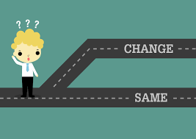
10.Map
Makes a new array by changing each item in an array.

Slide 12
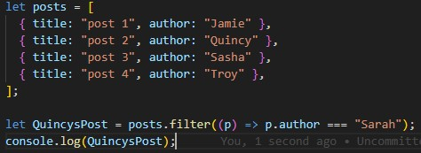
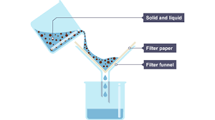
11. Filter
Makes a new array with only the items that pass a test.

Slide 13


Reduce
Combines all items in an array into a single value.

Slide 14


13. Some
Checks if at least one item in an array passes a test.

Slide 15
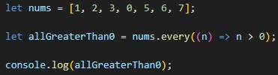

14. Every
Checks if all items in an array pass a test.

Slide 16
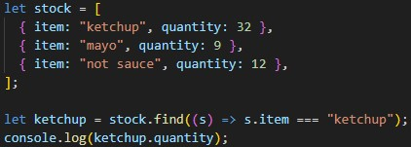

15. Find
Finds the first item in an array that passes a test.

Slide 17

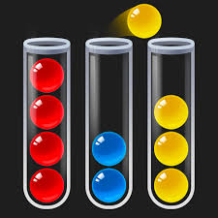
16. Sort
Sort Arranges items in an array in order.

